Slide 1


Avenger Assemble
PRS Mysteries
Emmanuella Matumamboh
Jacob Ayembilla
Frederick Kakembo
Kingsley Osei
Dr. Benson Kidenya
Caitlin Short
27 June 2025, Makerere University, Uganda

Slide 2
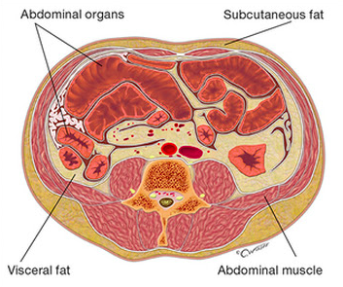
Background on topic:
Variations in Subcutaneous adipose tissue (SAT) distribution and volume are strongly influenced by genetic factors and are implicated in a range of cardiometabolic outcomes, including obesity, insulin resistance, and cardiovascular disease (Sanghera et al., 2019; Zhang et al., 2025).
Understanding the genetic architecture underlying the SAT is therefore vital for both biological insight and risk stratification in metabolic disorders.
Polygenic risk scores (PRS) have emerged as a powerful tool for quantifying
inherited susceptibility to complex traits by aggregating the effects of
multiple genetic variants.

Slide 3
Background on topic:
However, they may fail to capture the full polygenic signal or the correlation structure of the genome, potentially limiting their predictive utility (Truong et al., 2024).
Despite the growing availability and sophistication of PRS tools, limited work has systematically evaluated whether integrative methods provide meaningful improvements over single-source approaches in predicting SAT traits.
In this group, we determined whether integration of PRSs using elastic net regression will offer improved prediction in adiposity traits.

Slide 4
Study Motivation & Hypothesis
Research Gap
"Limited work has systematically evaluated whether integrative methods provide meaningful improvements over single-source approaches in predicting SAT traits"
Our Hypothesis
We hypothesize that PRSmix is NOT a better predictor of SAT levels in the African population than individual PGS scores
Study Objective
Compare predictive performance of:
Single-source PRS (individual PGS)
Integrative PRSmix (using Elastic Net)

Slide 5
Will PRSmix Predict Well?
Arguments AGAINST PRSmix Success:
Genetic Diversity Challenge
African populations have greatest genetic diversity globally
Shorter linkage disequilibrium blocks vs Europeans
Difficult transfer across ethnic groups
GWAS Bias Problem
86% of GWAS data from European ancestry
Missing African-specific variants with large effects
PRSmix cannot overcome fundamental data limitations
Population-Specific Architecture
Different allele frequencies across populations
Ancestry-enriched variants not captured in European GWAS

Slide 6
Evaluation Metrics
Primary Metrics Selected:
R² (Coefficient of Determination)
Measures variance in SAT explained by PRS
Interpretable percentage of trait variation
Standard metric for continuous outcomes
Correlation Analysis
Assesses linear relationship strength
Identifies best-performing individual PRS
Enables direct comparison between methods
Justification: These metrics provide clear, interpretable measures of predictive utility for continuous SAT measurements

Slide 7
Tools & Approaches Used
Programming Environment
Python Jupyter Notebook with NumPy, Pandas, Scikit-learn
Generated descriptive statistics and data visualization
Statistical Methods
Covariate Adjustment: OLS regression to remove age, sex, PC1-PC10 effects
PRSmix Construction: Elastic Net Regression (ElasticNetCV)
Model Validation: 80/20 train-test split
Performance Evaluation
Primary Metric: R² (variance explained)
Secondary: Correlation analysis between PRS and SAT
Benchmarking: Individual PRS vs integrated PRSmix
Why Elastic Net?
Handles correlated predictors (multiple PRS)
Automatic feature selection and weighting
Prevents overfitting in high-dimensional data

Slide 8




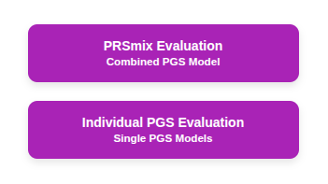
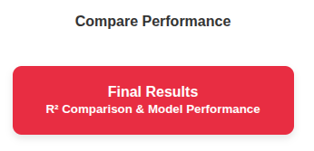
PRSmix Methodology

Slide 9
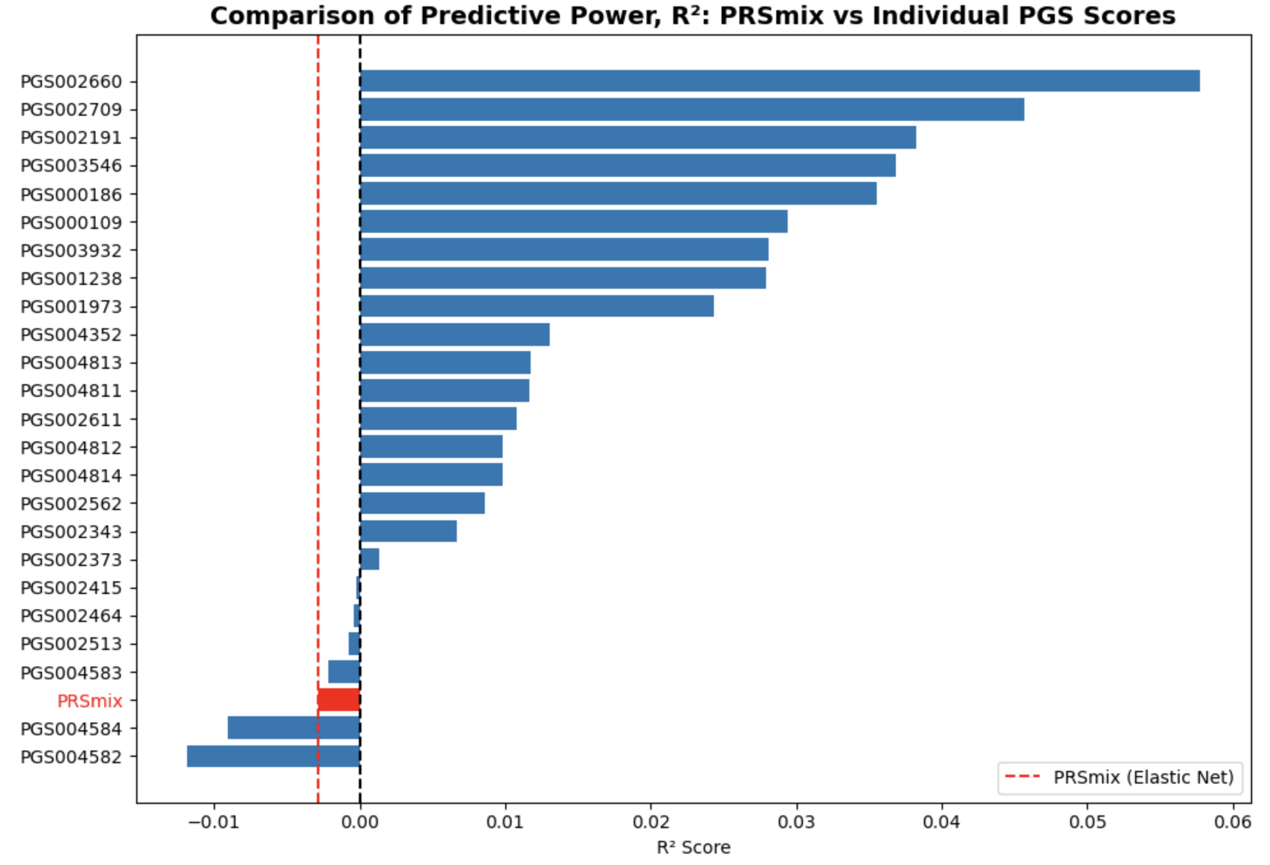
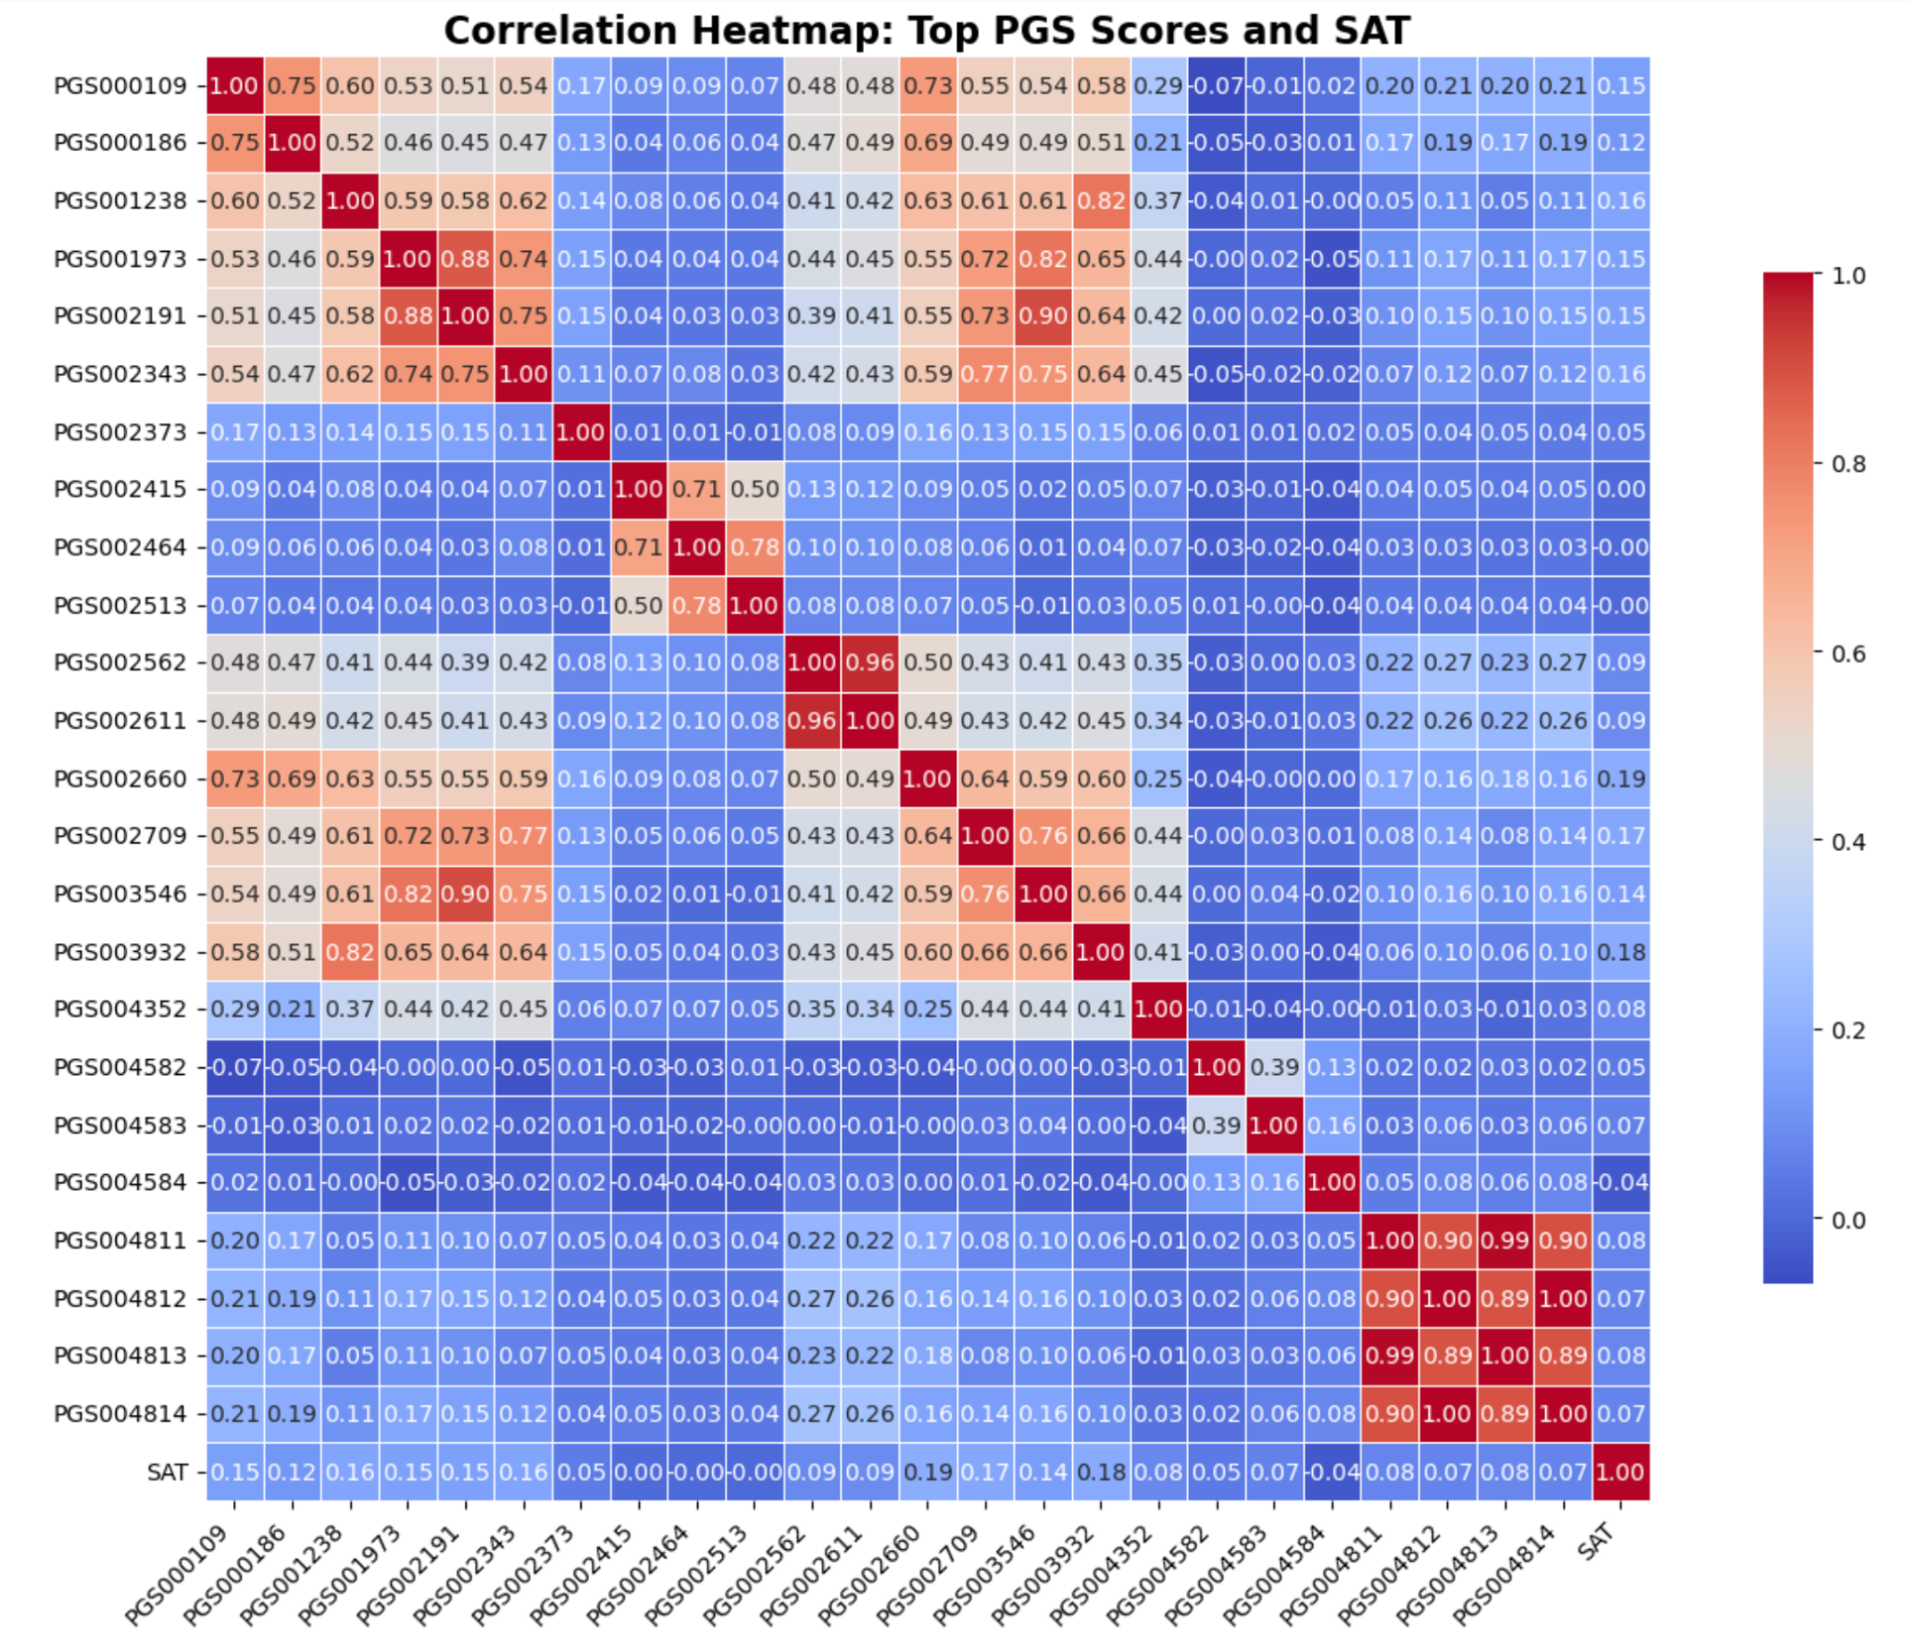
Results Visualization & Interpretation
Performance Comparison Chart
PRSmix: Negative R² (-0.0029)
Best individual PRS: Positive R² (0.057)
Clear superiority of single-source approach
Correlation Heatmap Insights
Overall poor correlations between PRS and SAT
PGS002660 strongest signal (r = 0.19)
Most PRS near zero correlation
Clinical Interpretation
Current PRS have limited utility for SAT prediction in Africans
Population-specific GWAS needed for meaningful predictions

Slide 10
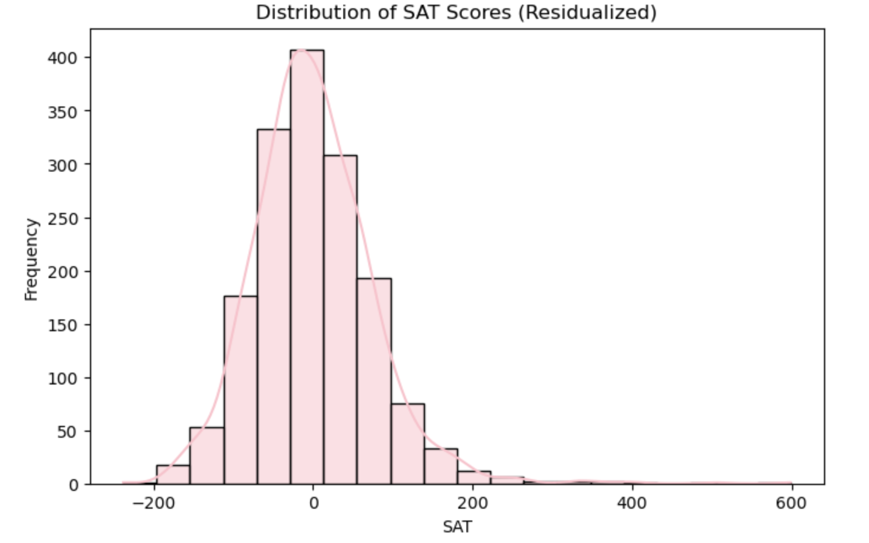
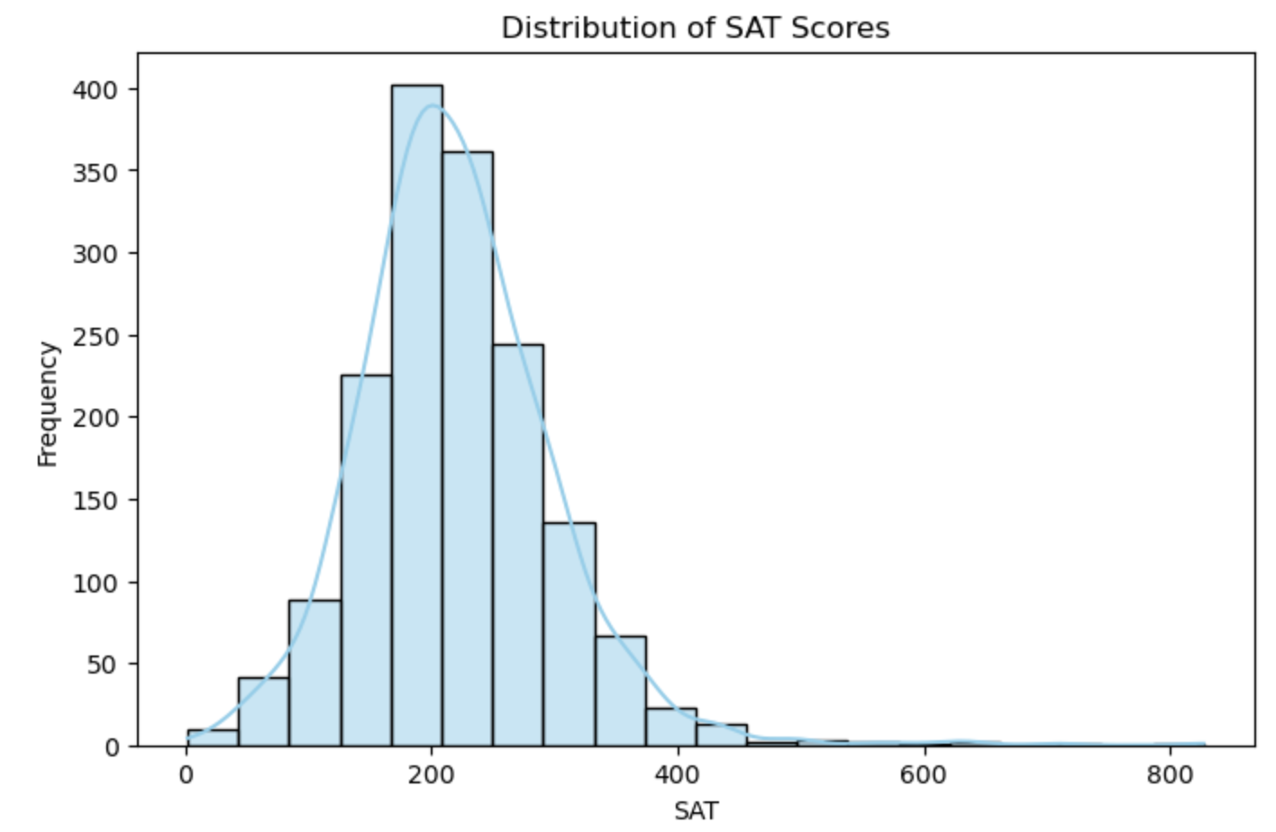
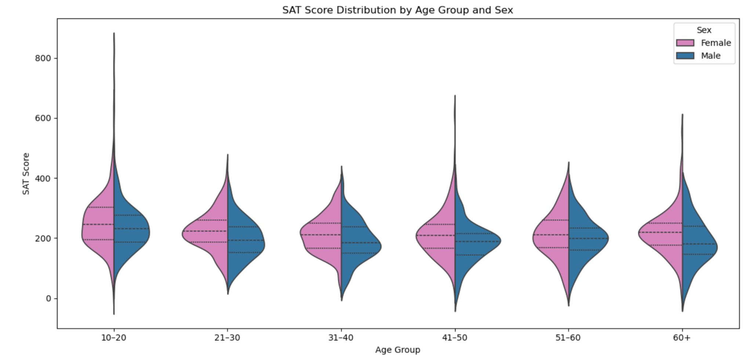
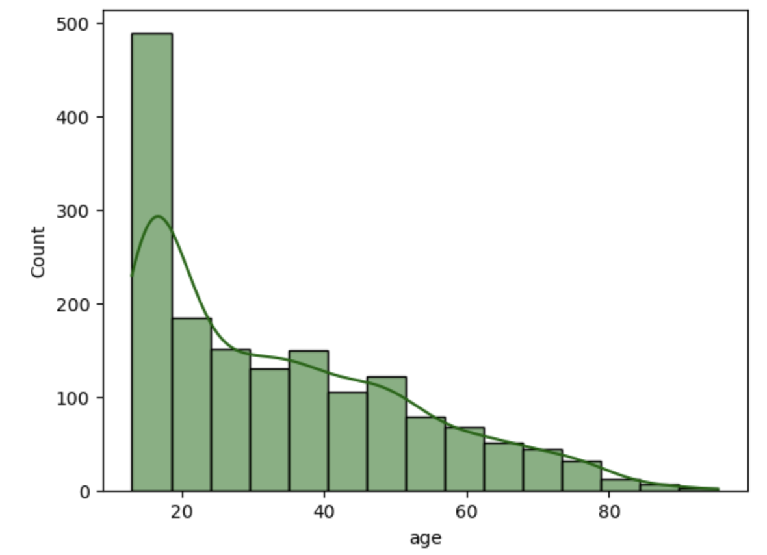
More Results

Slide 11
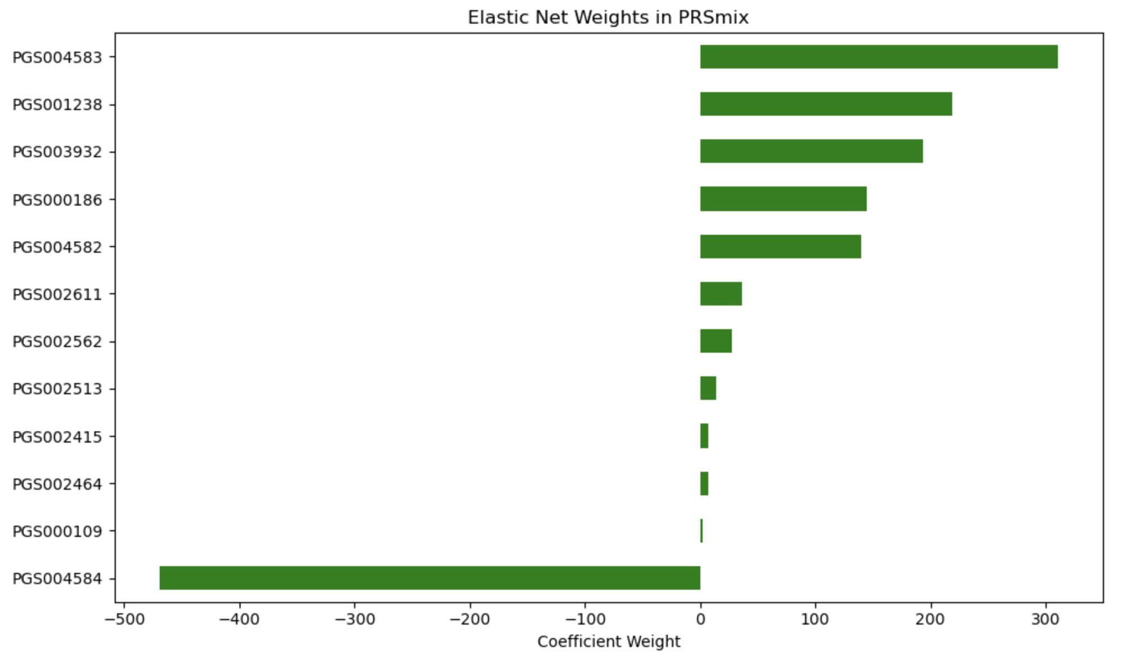

Slide 12
Discussion & Limitations
Why Did PRSmix Fail?
Eurocentricity of training data limits African applicability
Genetic architecture differences not captured
Integration amplified noise rather than signal
Study Limitations
Heterogeneous GWAS sources with different protocols
Imaging-based SAT measurements introduce variability
Limited African-specific genetic data availability
Clinical Implications
Current PRS insufficient for clinical use in African populations
Ancestry-matched discovery cohorts essential
Caution needed in clinical implementation

Slide 13
Thank You

